Slide 1
EE0005 Mini Project
Predicting Attrition of Employees
Done by: Sophia, Rachel, Marcus, Soo Yang

Slide 2
Staff Attrition - Loss of employees through a natural process, such as retirement, resignation, elimination of a position, personal health, or other similar reasons.

Slide 3
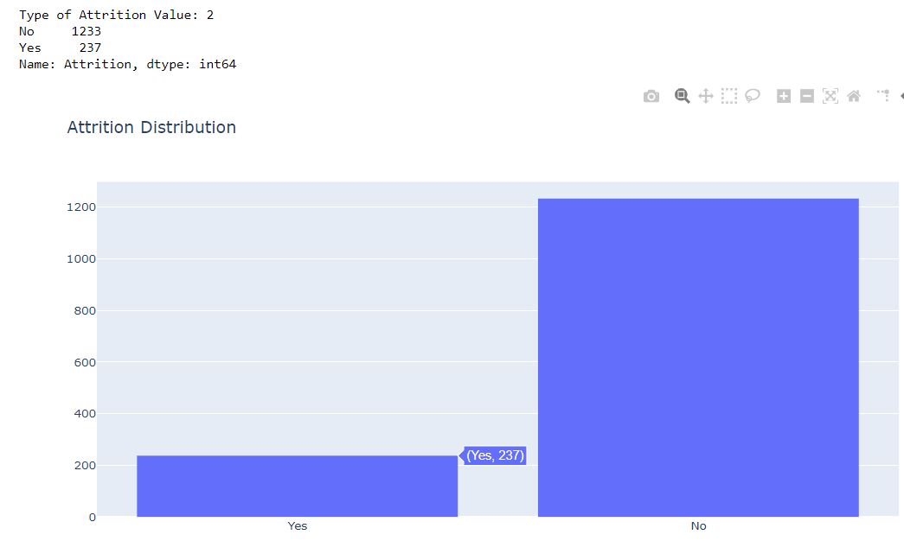
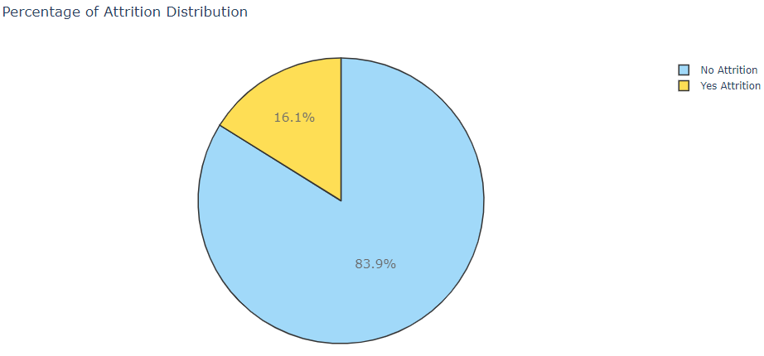
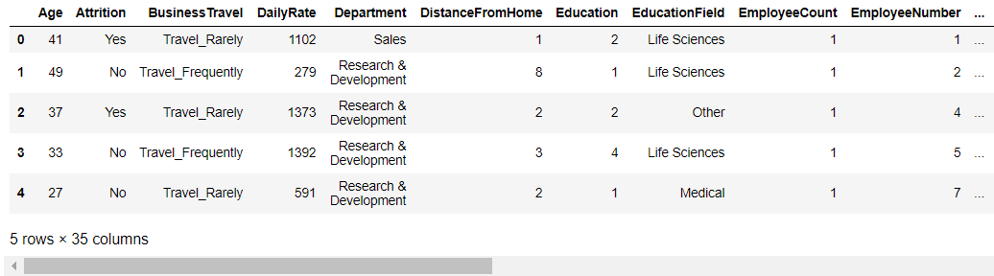
Exploratory Data Analysis
Check for missing values
Total number of Cols: 35, Rows: 1470
Summary of dataset: int62(26), object(9)
Used Plotly to show distribution histogram
Attrition (Main Focus): No - 1233, Yes - 237
Dropped irrelevant columns (e.g. ‘EmployeeCount’, ‘Over18’)

Slide 4
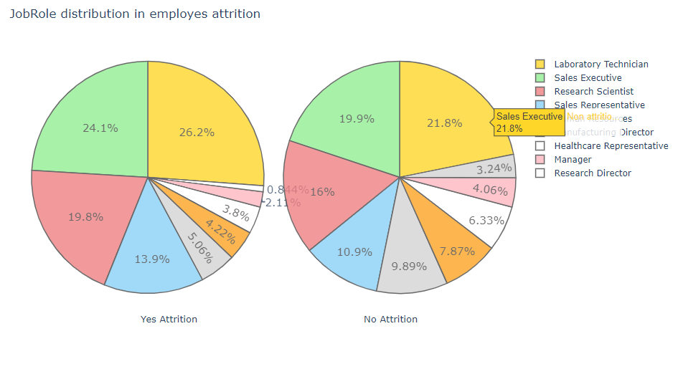
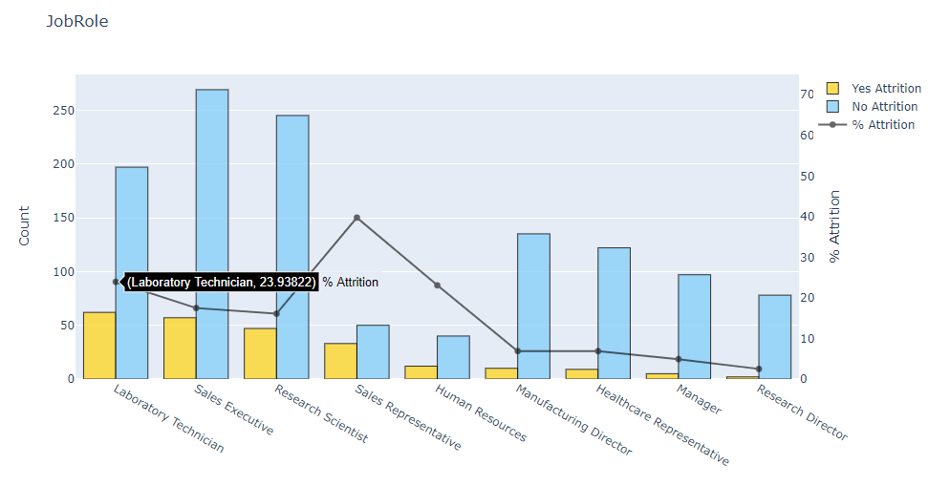
Visualisation of Data
Used Pie Charts and Bar Charts to visualise variables in Employees Attrition
For example, employees working as Laboratory Technician and Sales Representative are more likely to quit than workers in other positions

Slide 5
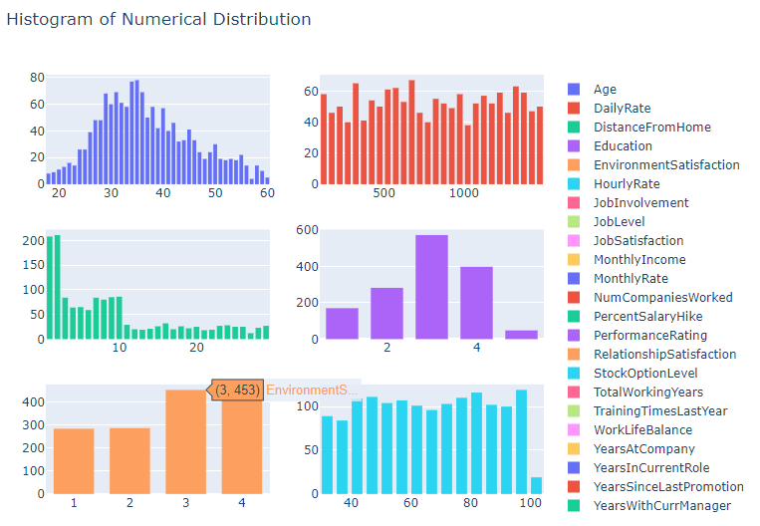
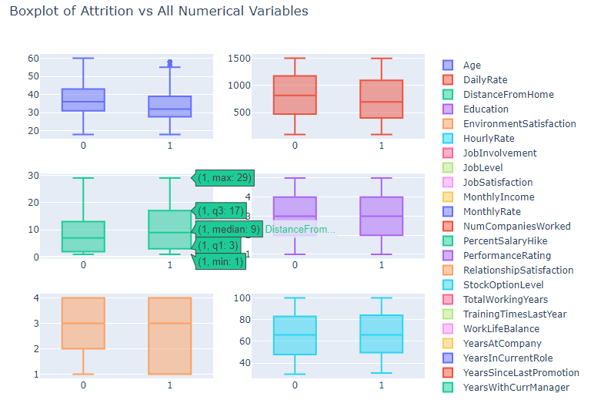
Visualisation of Data
Used Histogram and Boxplot to visualise variables in Employees Attrition
For example, employees that voted for “3” rating under EnvironmentSatisfaction have the Attrition Count of 453

Slide 6
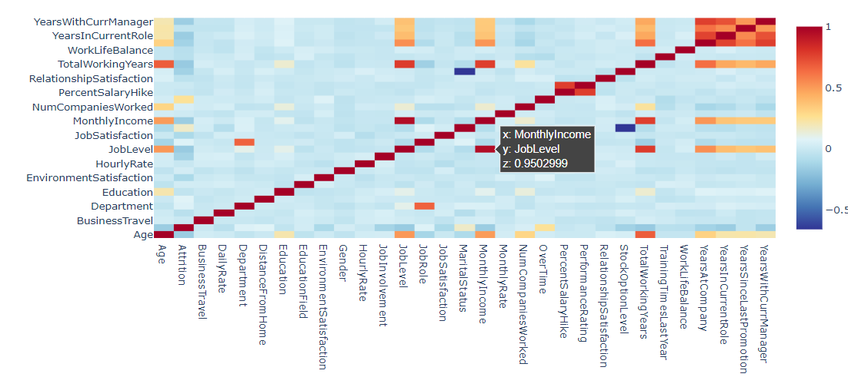
Correlation Matrix
Understand the correlation between multiple pair of variables
Used Plotly to plot Heatmap of relevant variables

Slide 7
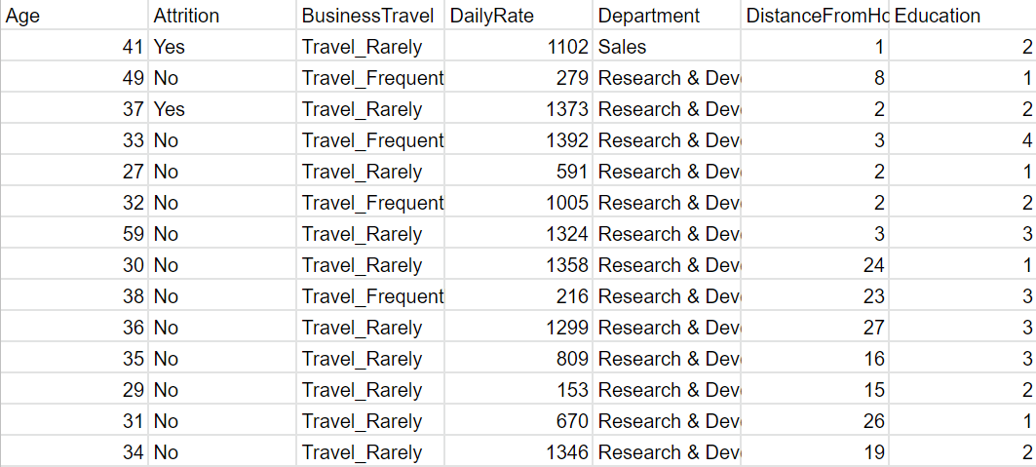
Data Set used: EmployeeAttrition.csv

Slide 8

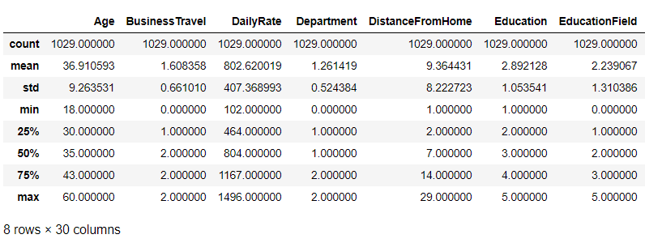
Data Preparation
Data is splitted into Train and Test set (70% - 30%)
Variables used are: X_train, X_test, y_train, y_test

Slide 9
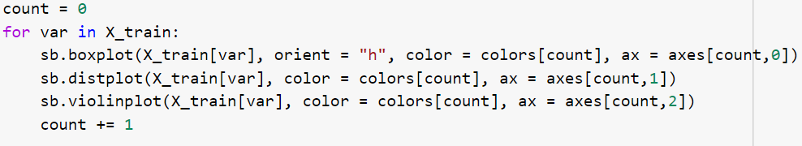
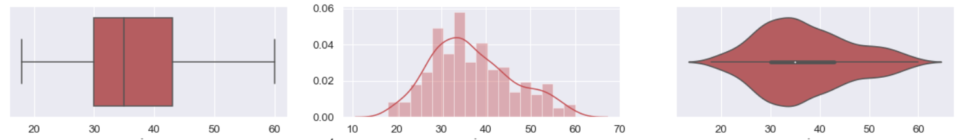
Machine Learning Application
Machine Learning Techniques that aided our objective:
To find distribution of Predictors: Box plot, Distribution plot, Violin Plot.
.
Eg. For “Age” Predictor: Employees in their mid thirties are likelier to quit
Notes:
visually show the distribution of numerical data

Slide 10
Decision Tree Classifier
Decision Tree Algorithm - Solve classification problems
Allows for predictive modeling machine learning that can be visualised
Simple to understand and to interpret
Simple data preparation
Not much restrictions of type of data used (can be categorical or numerical)

Slide 11
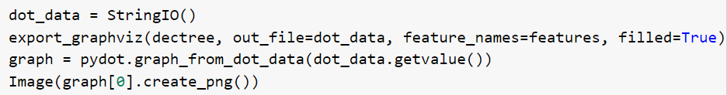
Carrying out Decision Tree
Used Train Data to Make a Decision Tree
Create a Decision Tree Object using DecisionTreeClassifier
Train the Decision Tree Model
Plotted the Decision Tree using Graphviz

Slide 12
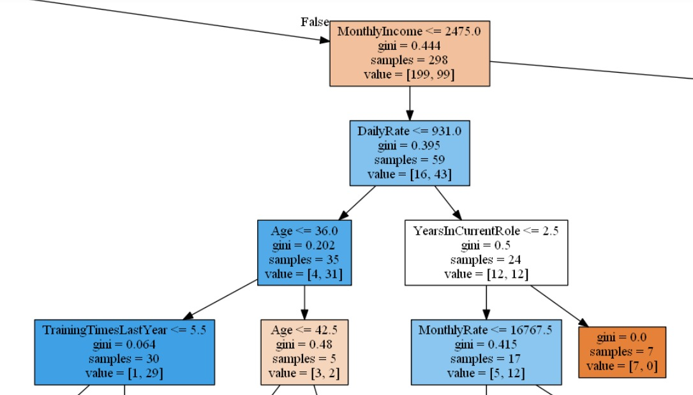
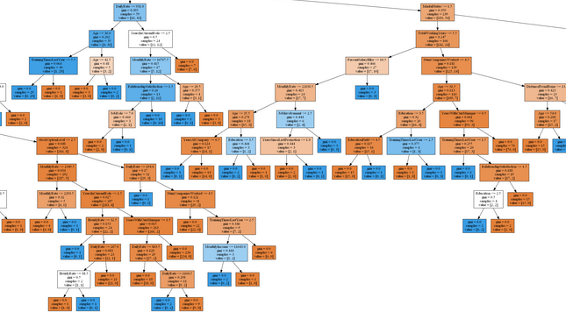
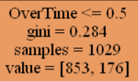
Observation from Decision Tree
Partitions
Pruning
Gini index

Slide 13
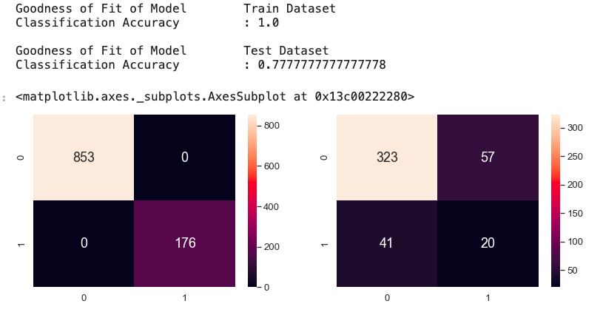
Accuracy of Decision Tree

Slide 14
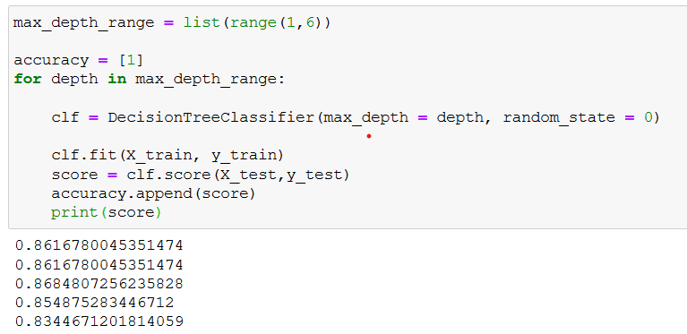
Accuracy of Decision Tree

Slide 15
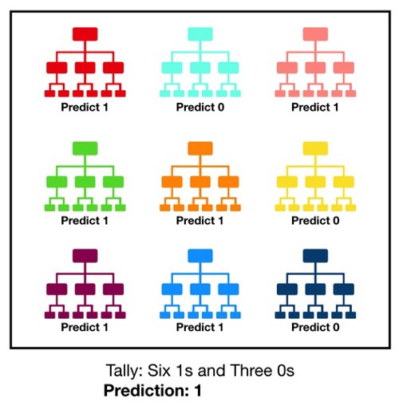
Random Forest Classifier

Slide 16
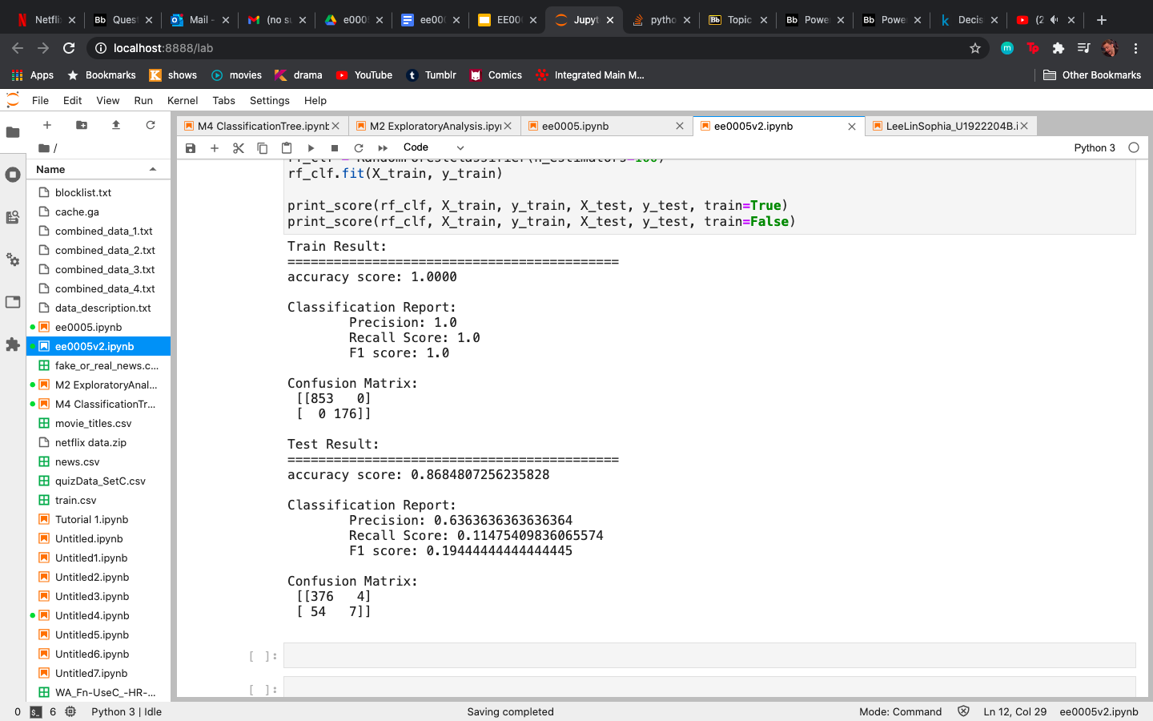
Random Forest Classifier

Slide 17
Parts
Marcus: Exploratory Data Analysis Visualisation of Data | Rachel: Data Preparation Data Analysis on Test and Train Data
Soo Yang: Decision Tree Decision Tree Analysis | Sophia: Hyperparameters tuning Random Forest Classifier Accuracy Comparison

